Slide 1


Financial education
Notes:
Key stage 2
1

Slide 2
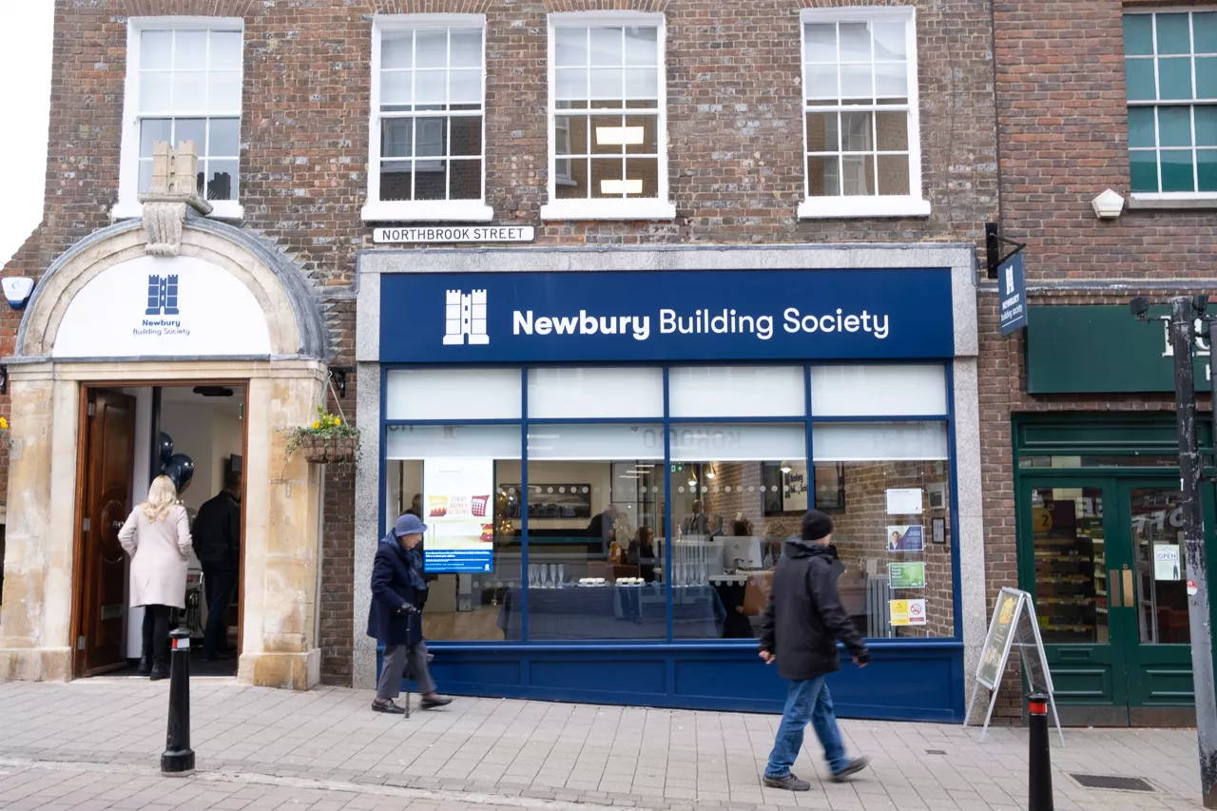
Who are we?
What is a Building Society?
When might you use one?
Notes:
Talk to your partner – can you answer these 3 questions (reveal each and read aloud)

Slide 3

Mortgages
- a special loan
Notes:
Discuss the word ‘mortgage’ - a loan to help you buy a house/property which you have to pay back over time plus interest (extra – we will find out more about this later) You can get a loan from a bank or a building society.
The building society, like NBS, will want to make sure that you can afford to pay back the loan which is usually taken out over a long period of time eg 15-20 years. When you take out any loan you are in debt that means you owe somebody and have to repay them. Often, like with a mortgage, you end up repaying them more than you borrowed.
3

Slide 4
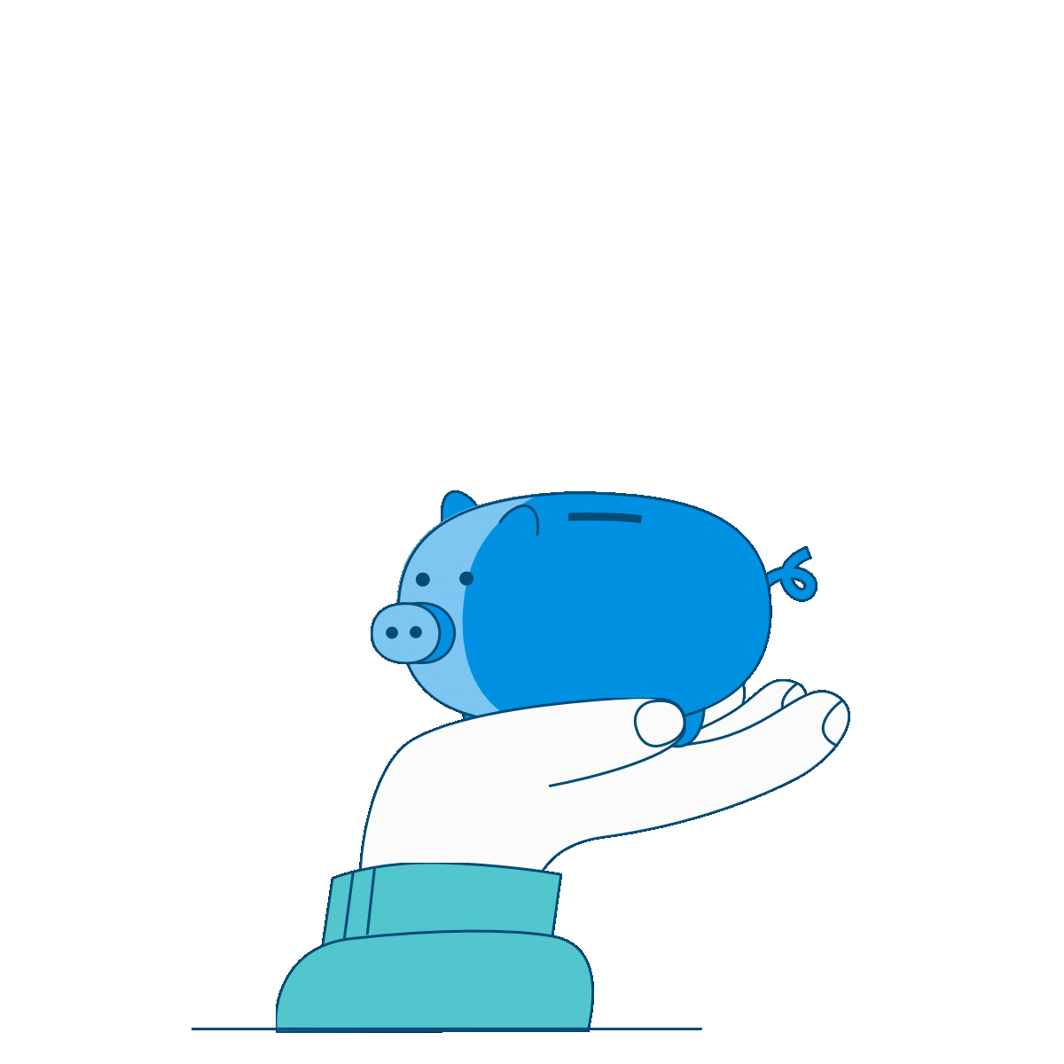
Savings
Notes:
Discuss saving: A building society or bank is a safe place to keep your money if you want to save up for something special like a holiday or a car. When you put your money into a savings account it grows with something called interest. We’ll find out more about this later. You can pay money into your savings whenever you want – this is called making a deposit. You can take money out to buy things with and this is called making a withdrawal.
4

Slide 5
Paying for things
What are the different ways we can pay for things?
Are there any risks when paying for things?
Notes:
Launch each question and ask groups to discuss in pairs and write down ideas on whiteboards– ready to feedback via next slides.

Slide 6
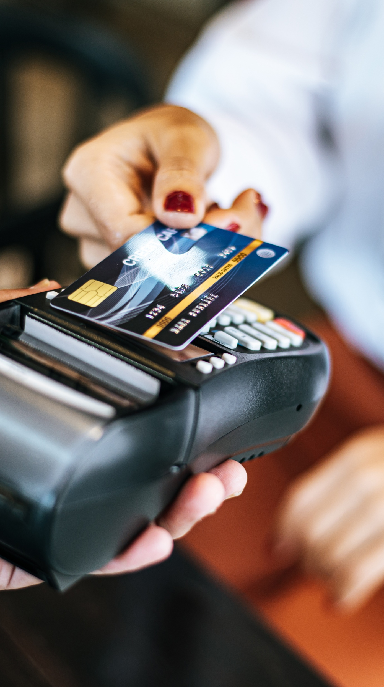
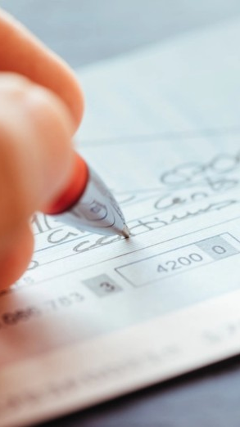
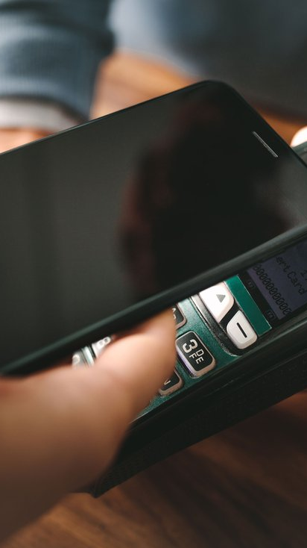
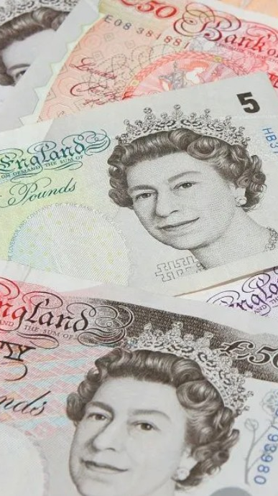
Different payment methods
Notes:
Discuss each with their participation
Can they recognise the different ways we pay for things – any other ways eg store cards/prepayment cards/online/direct debits/standing orders? Next slide explains the difference between a debit and credit card.

Slide 7
Credit and Debit cards
Debit Card
Think of a debit card like a key to your own money.
You can only spend the money that’s already in your bank account.
If you don’t have enough money, the card usually won’t work.
It’s like using your pocket money — once you spend it, it’s gone until you get more.
Example:
You have £20 in your account. If you buy something that costs £15, you’ll have £5 left.
Credit Card
A credit card is like borrowing money from the bank for a little while.
The bank pays for things now, and you pay the bank back later.
If you don’t pay it back on time, you may have to pay extra money (called interest).
It’s like borrowing money from a friend — you must remember to give it back.
Example: You buy a £200 item. The bank pays for it now. At the end of the month, you pay the bank £200.If you're late paying, you might have to pay more (interest).
Debit cards help you stay within your budget.
Credit cards help you buy big things safely and build a good repayment record.
Notes:
Explain the difference between the 2 as simply as possible. Explain that if they are going to use a credit card in the future (once 18) to pay for things they must be certain that they can afford to pay it back otherwise they could end up paying back a lot more than the item cost in the first place. Credit can be good though because it allows you to buy more expensive things and pay them back over time. Having a credit card (and paying it off) lets banks and building societies know that you are responsible with your money and helps you get bigger loans like a mortgage.

Slide 8
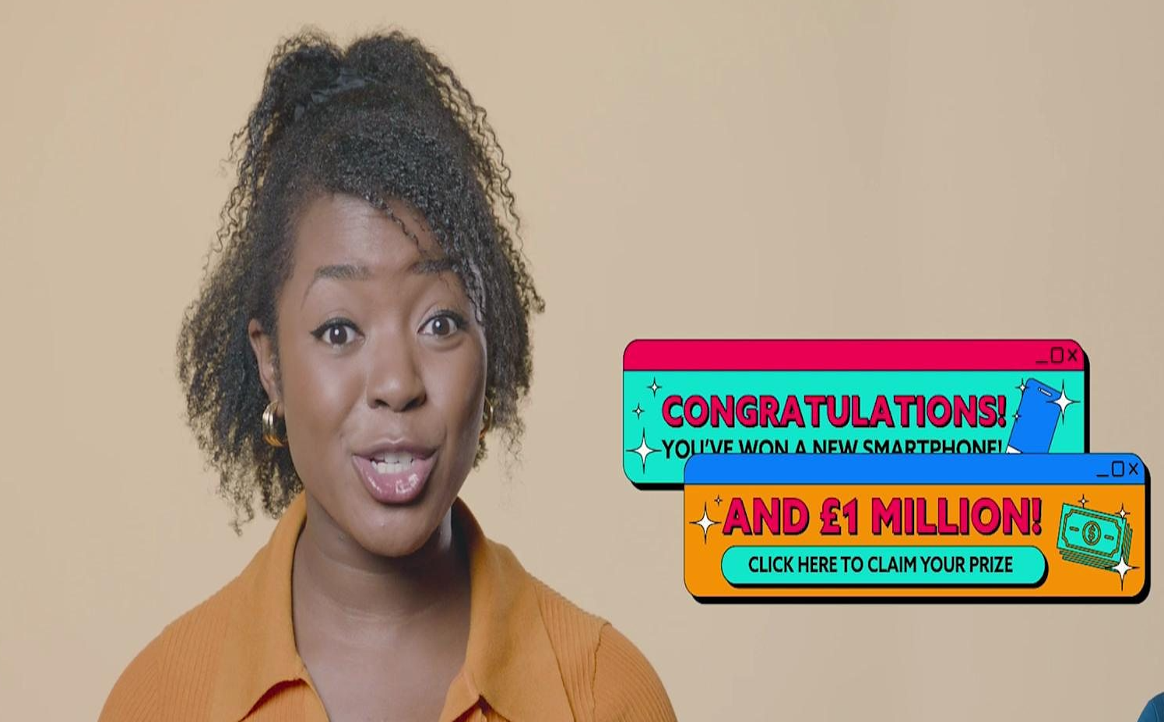
Are there any risks when we pay for things?
Click here to watch the BBC Bitesize film
Notes:
Watch the short video from BBC and discuss with the class. This video was produced in partnership with Childnet for Safer Internet Day 2025, which is based around the theme: Too good to be true? Protecting yourself and others from scams online

Slide 9
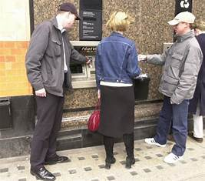
Things to remember?
If using a cashpoint – always take care to hide your pin number.
Create strong passwords when using online platforms.
Never share your personal details with anyone else or on websites.
Only use well-known apps, websites and games – watch out for fakes.
Be cautious about opening links, especially if they’re from someone they’ve never met.
If it sounds too good to be true, then it probably is – and could be a scam.
Show your trusted adults anything that appears strange
Notes:
Use picture to prompt a short discussion – explain importance of security at cashpoints, keeping pin numbers safe.
Go through the things to remember together.

Slide 10

What are needs and what are wants?
Notes:
Explain that there are some things we need to buy that we cannot avoid. There are other things that we could do without if we needed to. Also some things we don’t pay for straight away and we need to save up for.

Slide 11



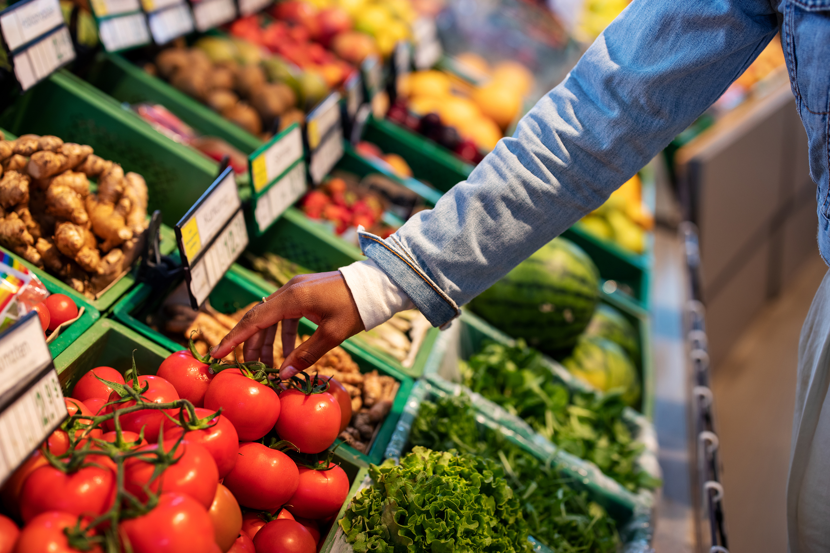
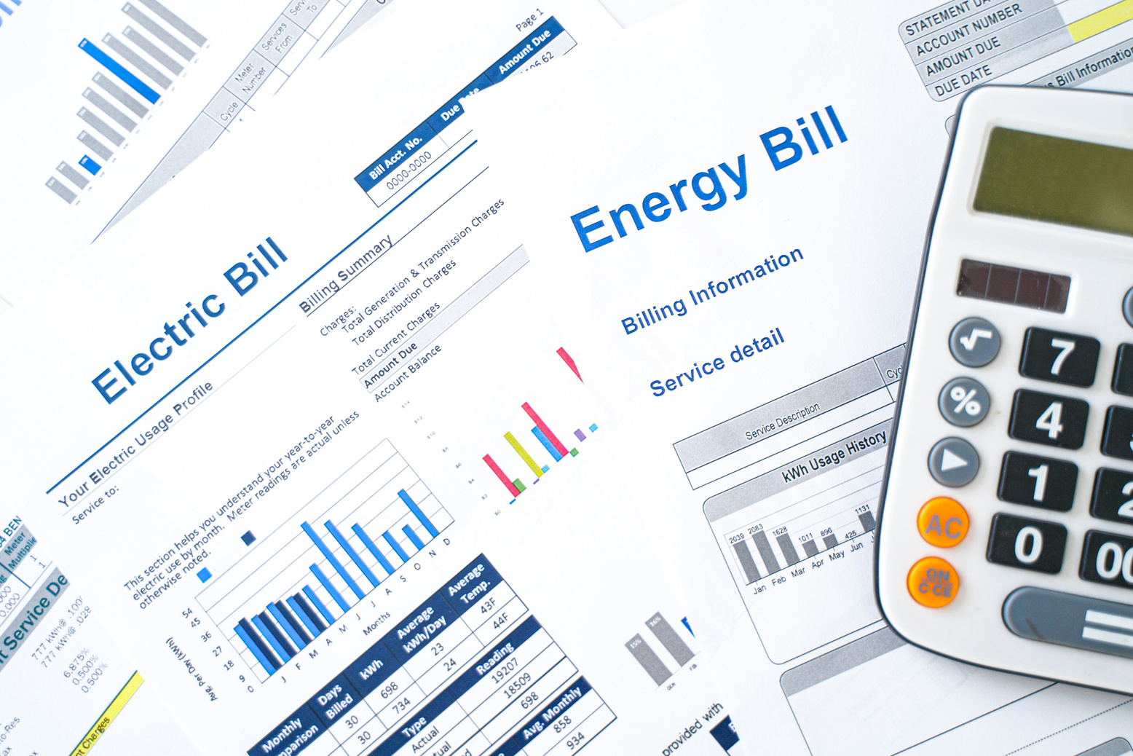
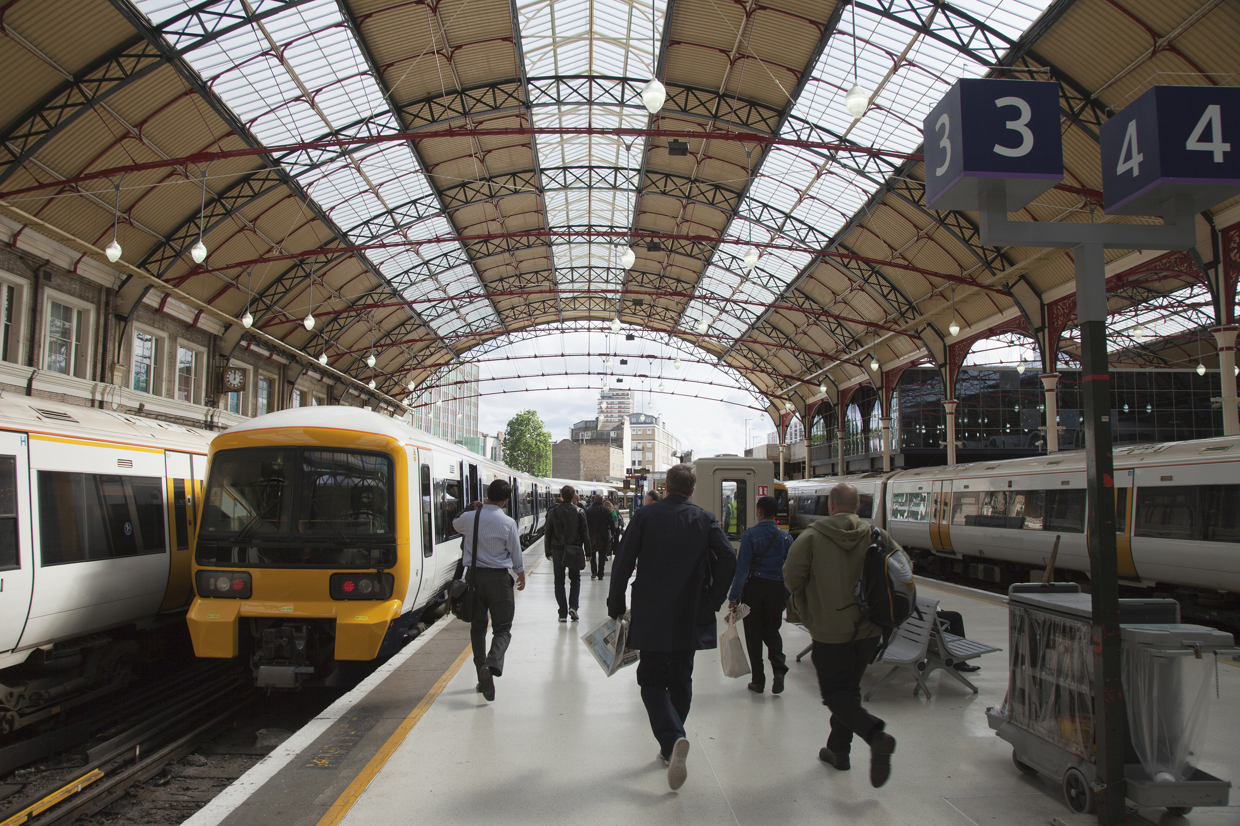
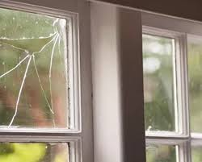
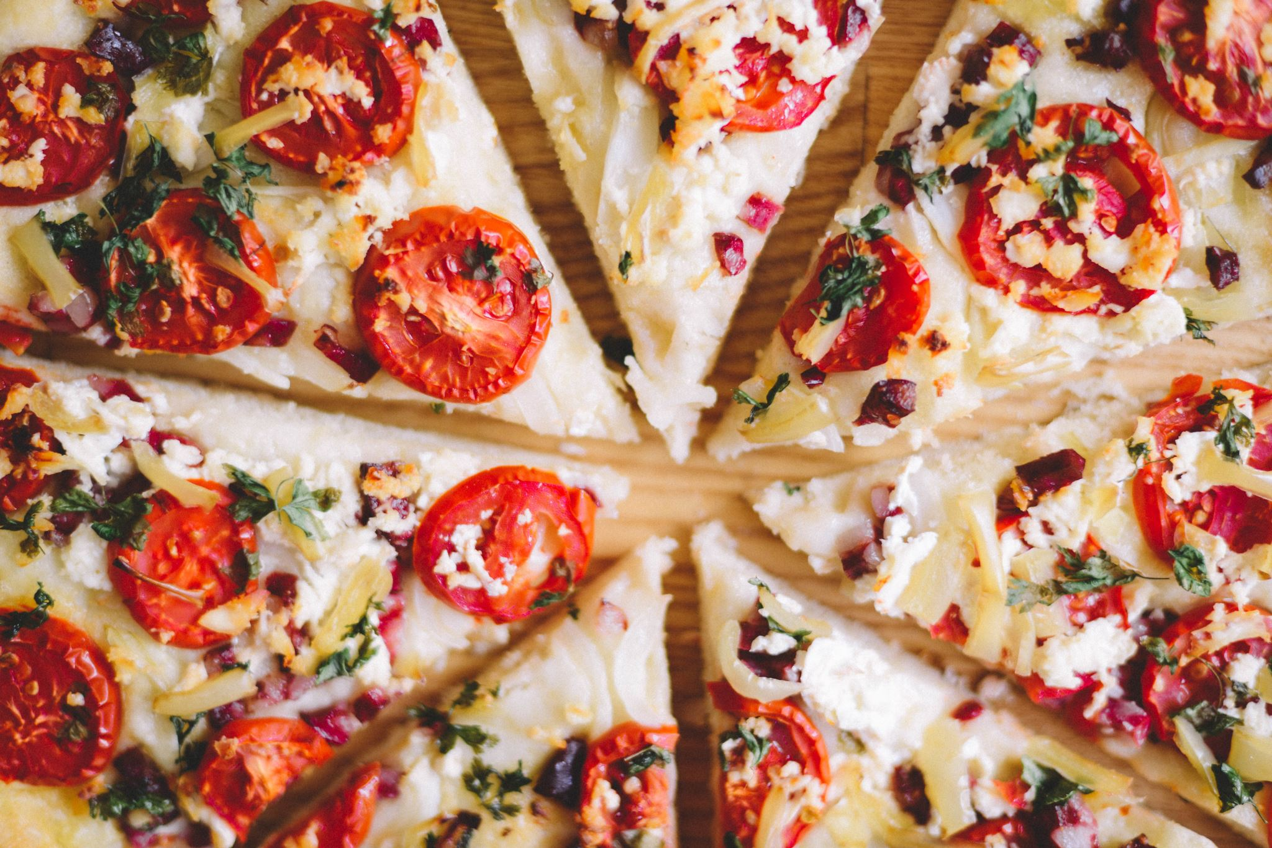

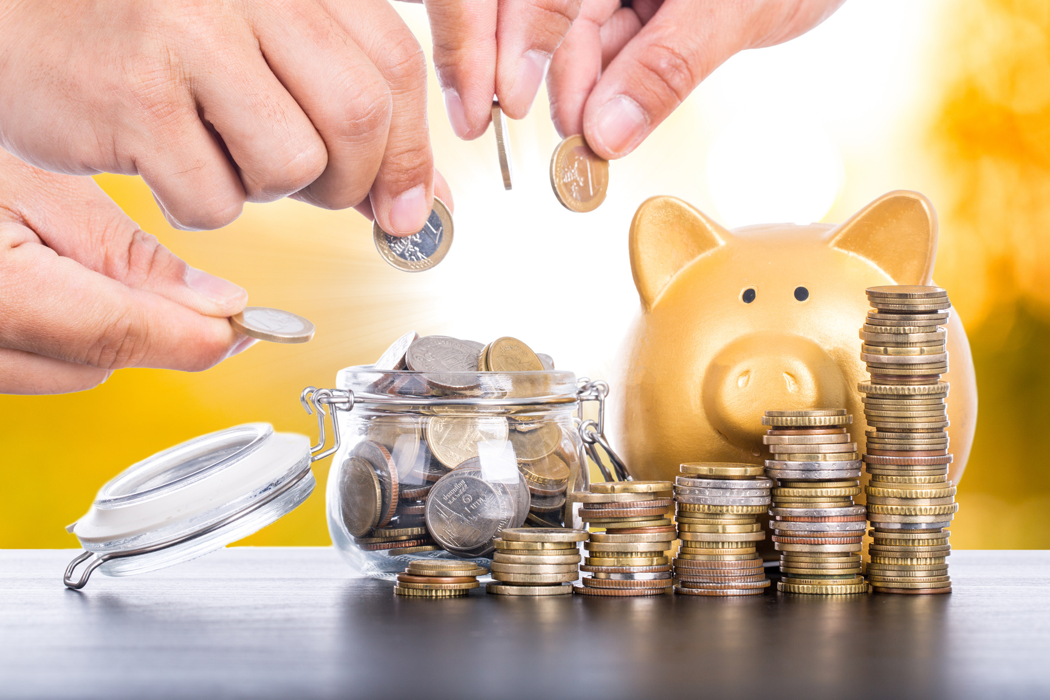
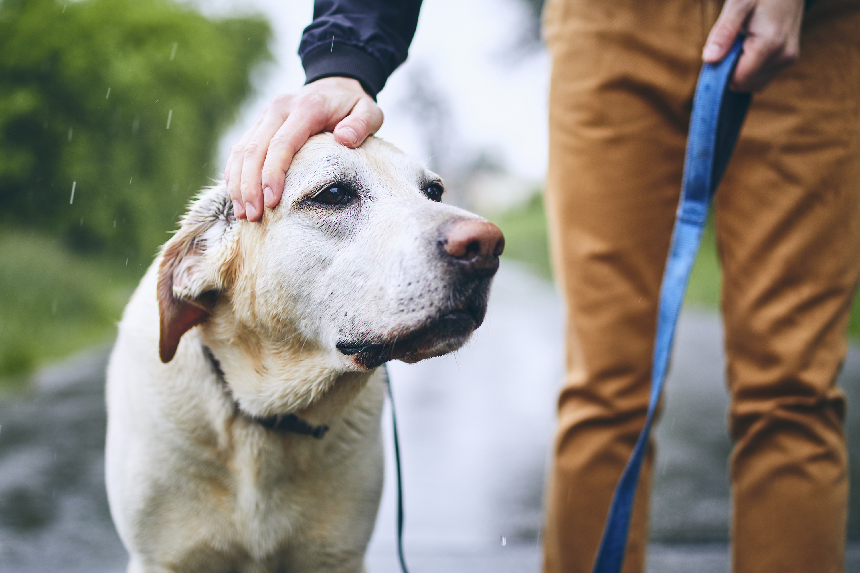
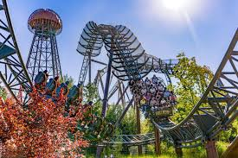

Paired activity Can you sort this spending into 3 pots:
Saving for a holiday | Buying a new game | Paying your mortgage or rent | Buying your weekly food
Paying your bills | Buying a train ticket to get to work. | Save for emergencies like repairs | Take out pizza
Save up a deposit for a house | TV subscriptions | Caring for pets - costs | Trip to a theme park
Needs
Wants
Save for future
Notes:
Explain the activity – they need to sort each type of spending into one of the 3 pots – they can do on mini whiteboards if available in pairs/table groups

Slide 12

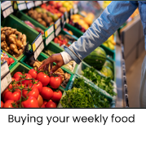
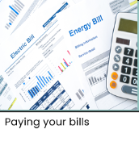
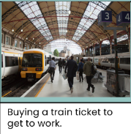
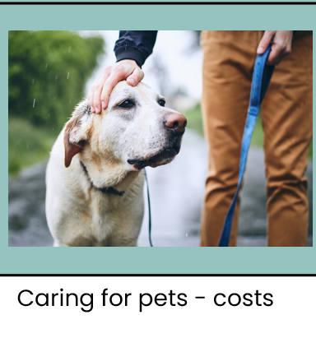
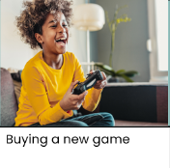
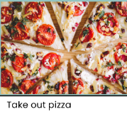

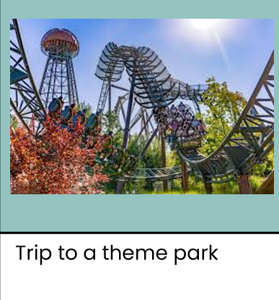

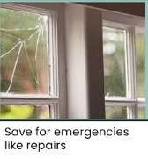
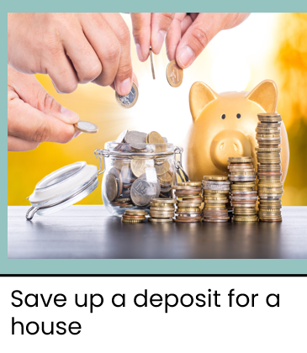
Answers
Needs
Wants
Save for
future
Notes:
Go through the answers and discuss

Slide 13
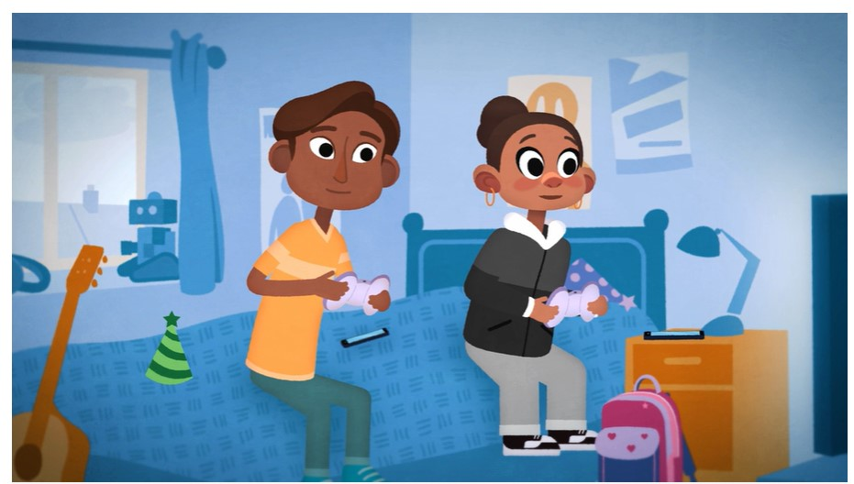
Are we always careful about what we buy?
Gaming payment models - BBC Teach
Click the link to watch the video from BBC Schools
Notes:
This video shows how when gaming there are different payment methods incl : paying upfront/by subscription and in app purchases
*I know that some things are better value for money than others.
*I can make comparisons between prices when deciding what is best value for money, including for services such as electricity, phones and the internet.
*I understand why making informed decisions will help me make the most of the money I have.

Slide 14
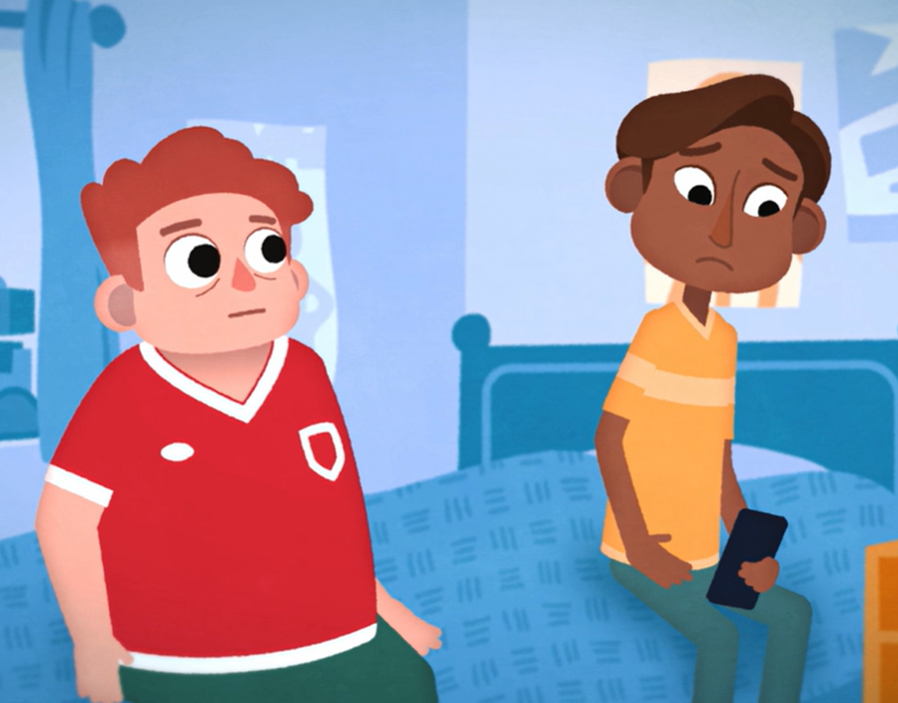
Saving vs borrowing
What is interest?
What are the benefits of saving money in a bank account?
What are the risks of borrowing money?
Why might someone choose to borrow money?
BBC Schools
click to watch
Notes:
Click to watch the animation from BBC schools - This animated video explains interest: the money which can be added to the money that we save or borrow.
Discuss the questions together.

Slide 15

Interest rates can go up as well as down!
When they go up:
☺ You get more money added to your savings
☹ You have to pay more on any loans you have.
When they go down:
☹ You don’t get as much added to your savings
☺ You don’t have to pay back as much on your loans.
%
Notes:
Explain as a summary

Slide 16
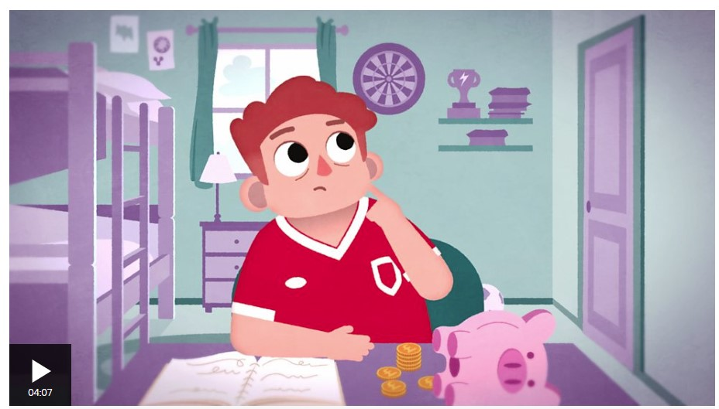
Being wise with money
Why might keeping a record of what you save and spend be helpful?
What are some ways you might keep a record of your spending and saving?
How does a bank account help you to keep track of your savings and spending?
What is the difference between a debit card and a credit card?
Keeping track of spending and savings: being wiser with my money - BBC Teach
Notes:
Watch the video and discuss the questions.
Why did Sujit not manage to get to the concert?
What had Dylan done well?
Keeping track of saving - Keeping a record of what we spend and save helps us to stay in control of our money. Learning how to do this at an early age is a great life skill to have.
Leads into the activity

Slide 17
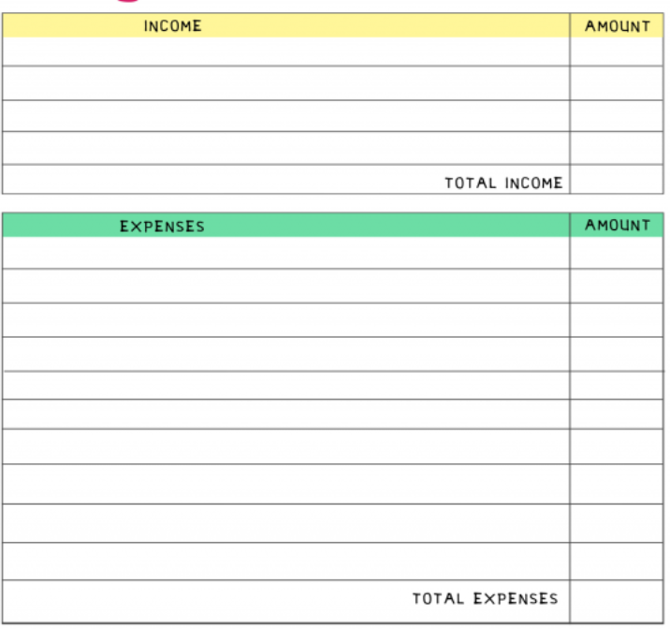
Budgeting can
be simple
Understand what money you have coming in - Income
Jobs
Gifts
Allowances
Understand what you will be spending that money on - Expenses
Things you need
Things you want
Saving for the future
Notes:
Budgeting is simply about understanding how much money you have got and deciding what to spend it on or whether to save it. A simple budget sheet can help you keep track of that.

Slide 18
Easy ways to budget
The 50 30 20 rule or budget divides your monthly money into three clear areas. Make sure:
50% of your money is used for needs. This can cover everything from bills to food shopping.
30% is spent on any wants. Think days out with your family, dinner at a restaurant or any holiday plans.
20% goes towards savings. This includes things like topping up your emergency savings fund or setting aside money for big events in the future.
If we have £100
£50
£30
£20
50% - Needs
Things that you have to spend now like your rent, food and bills.
30% -Wants
Fun things like going out, treating yourself to a new game.
20% - Savings
Things you might need to pay for in the future like a holiday, or an emergency fund in case things go wrong.
Notes:
Budgeting means deciding what to spend your money on each week/month and prioritising the important stuff!

Slide 19
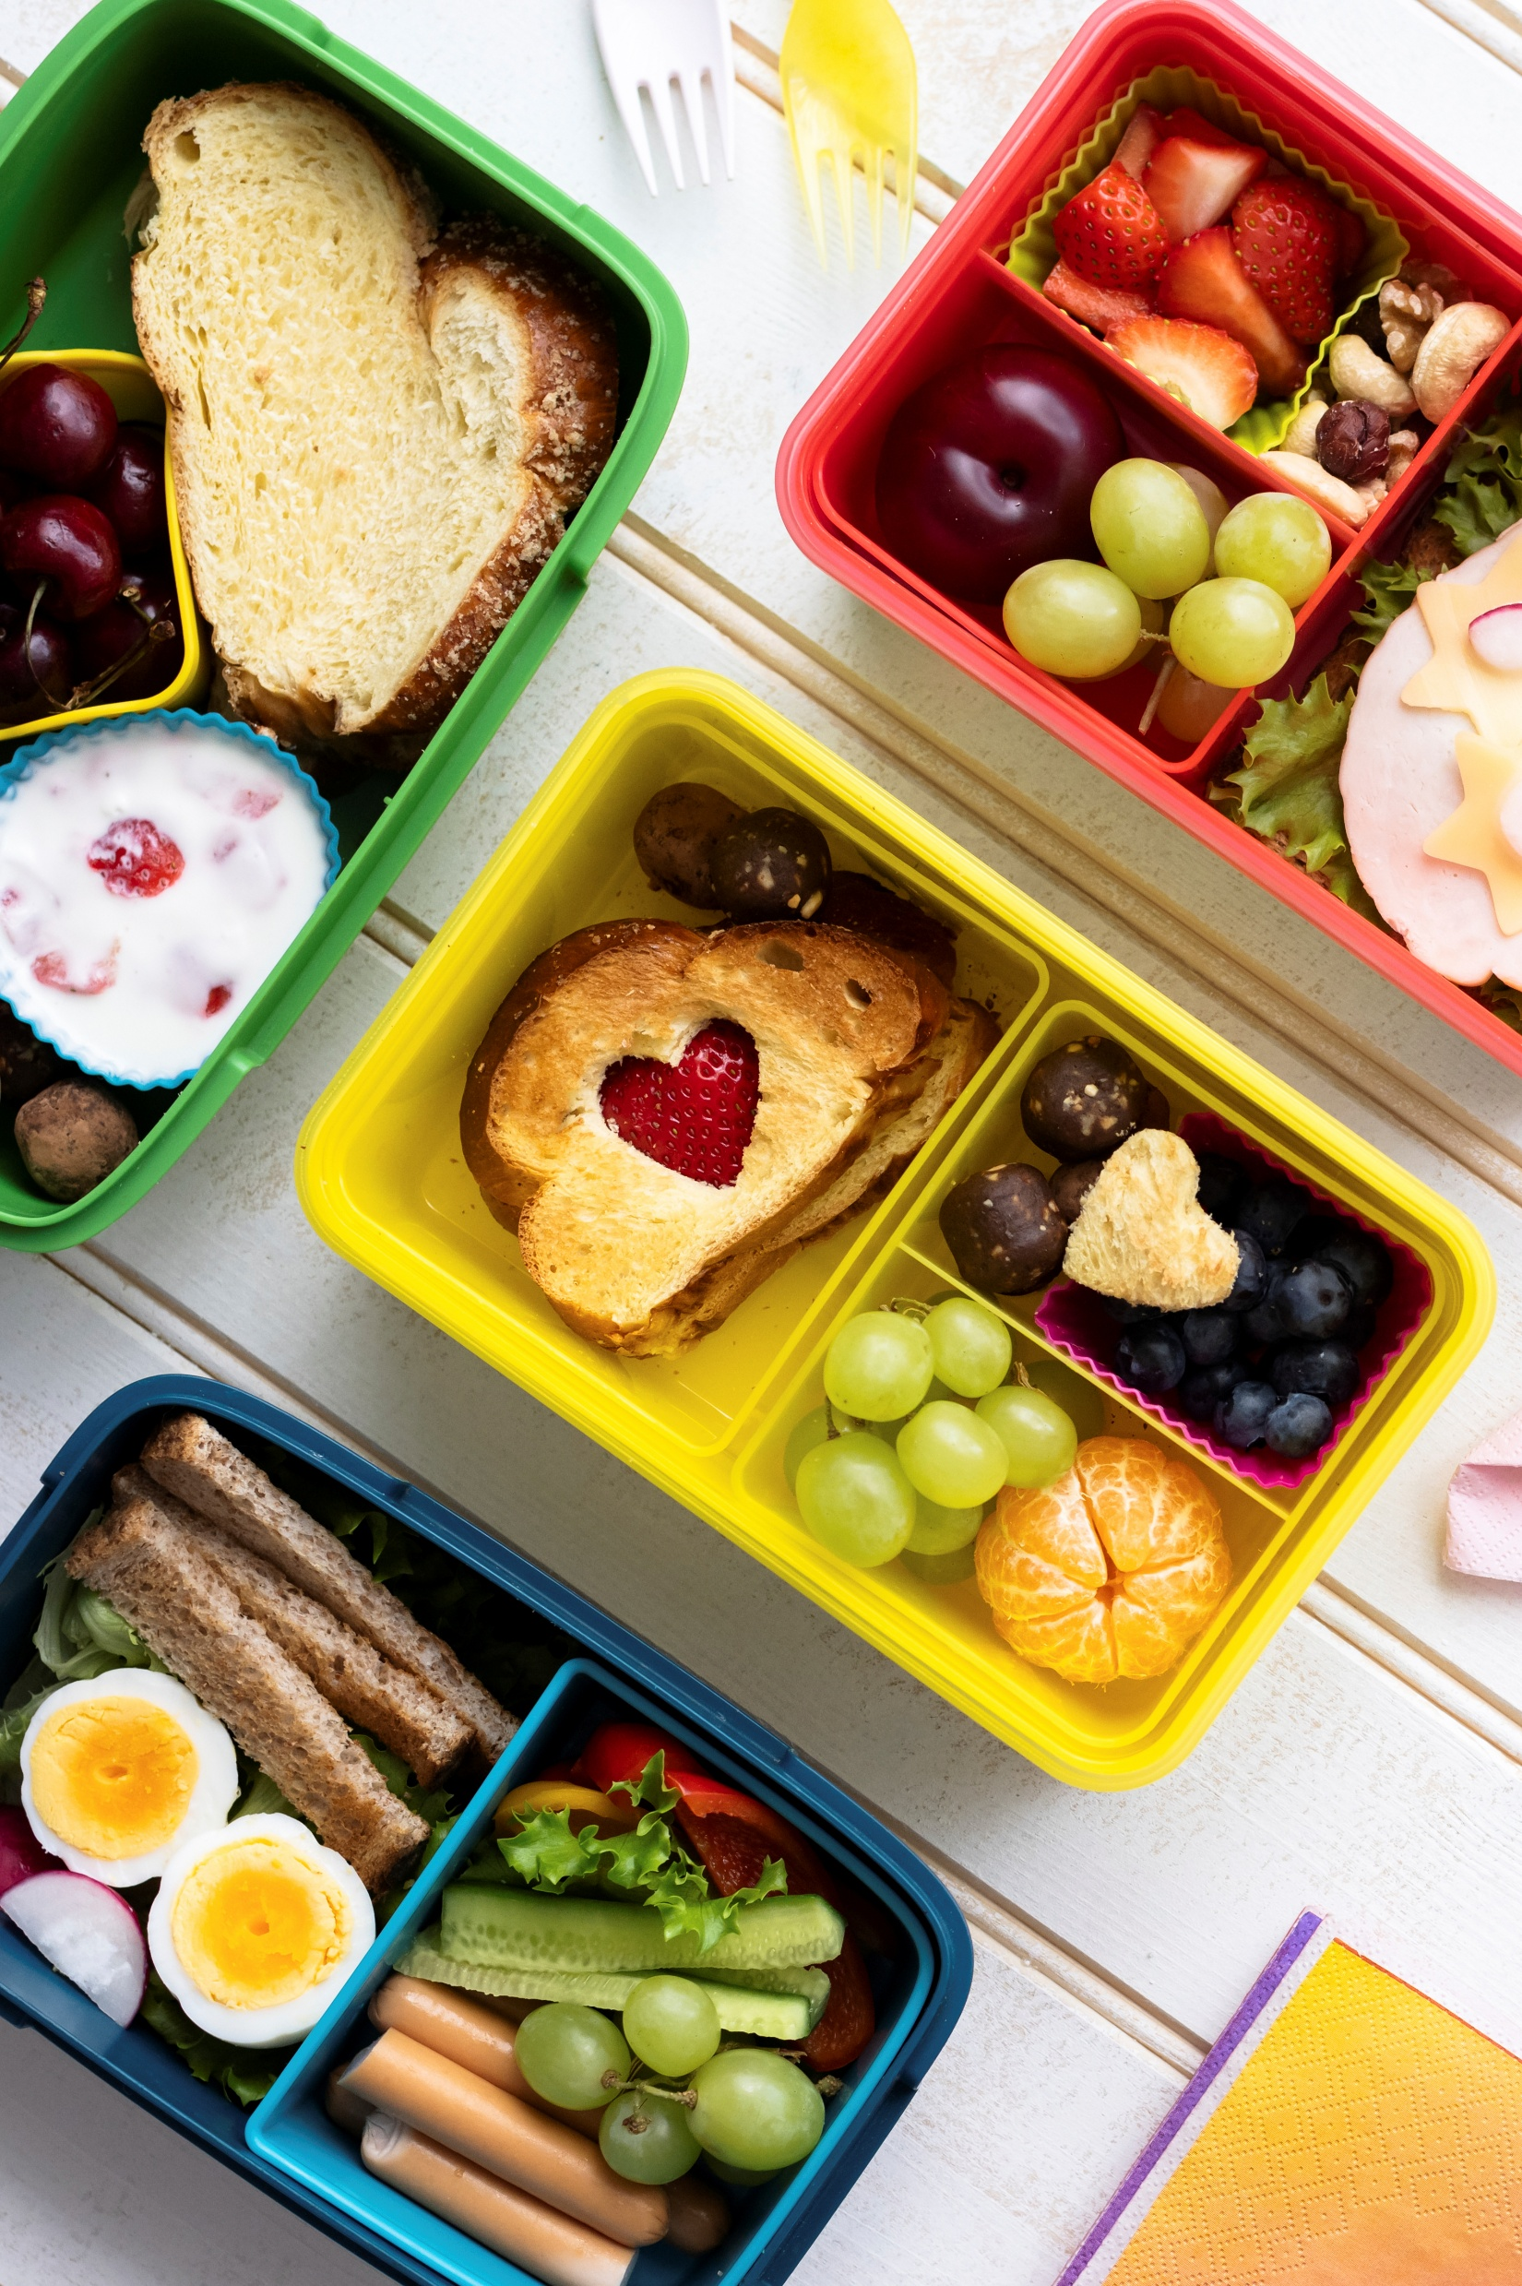
Other ways to help
your budget
Look at your bank account each month to see what you are spending money on.
Could you reduce what you are spending or generate more income?
Example - instead of buying a lunch from a supermarket
you could?
- Make your own packed lunch
Instead of You could?
Catching the bus………………….
Buying new clothes………………
How could you make more money?
Notes:
You can save money as well by changing some of your spending habits – can they think of any others?

Slide 20
Activity time

Slide 21

Budgeting
Your group are saving up to go to an event. The cost to get in is £35 per person. There are also transport costs of £6.00 per person.
Will you want to buy merchandise when you are there?
You are working as a team to generate the cash needed to pay for the tickets, transport and possibly merchandise.
As a group – use the budget sheet to work out:
How much it will cost in total (see list of merchandise available)
How much income you can generate by doing different jobs – see jobs list and what they pay.
Use the budget tracker to keep track of what you are saving (from earning) each week and therefore how long it will take you to save up to go.
Important: You can only do max 5 jobs per week AND each job can only be done by one member of the group each week. All jobs must be done at least once.
Notes:
Explain the group activity:
Each group is saving up to go to an event (they can decide what it is if want otherwise just say it is a concert) The cost to get in is £35 per person. There is also transport costs of £6.00 per person. Will they want to buy merchandise when there? (There is a generic merchandising list that they can consult)
They are working as a team to generate the total cash needed to pay for the tickets, transport and possibly merchandise.
As a group – they should use the budget sheet to work out:
1. How much it will cost in total (tickets, transport and merch if want)
2. How much they can generate by doing different jobs – see jobs list and what they pay – MAX 5 jobs per week and all jobs must be done at least once in the schedule.
Use the budget tracker to keep track of what they are saving each week.
SEND/ less able - adult support needed. Calculators on hand if needed.
Potential holding activity – design a poster to persuade people that they should save money

Slide 22
What have we learnt today?
Mortgages are loans to help you buy a house
You have to pay back loans over time and interest is added. What you owe is called a debt.
Savings is where you put your money in a safe place like a bank or building society – it will grow with interest.
Interest can go up and down – which changes what we owe or earn.
Take care when spending money – be careful of pop ups and links that may not be safe.
Budgeting helps us choose what we should spend our money on – at least half our money should go on essential things we need and the rest on wants and savings.
We can spend less to help us save money by making small changes to our habits.
Notes:
Run through key learnings – any questions?

Slide 23

Notes:
Any outstanding questions? Before leaving – show the children the poster for the Caketastic competition and hand out entry forms to anyone interested.

